Slide 1



STUDENT DETAILS
SKILLS BUILD EMAIL ID:
lavanyanarayanare@gmail.com
Karnataka, India
DGT
Name: Lavanya.N
College:
Dr. Ambedkar Institute of Technology, Bangalore
Karnataka
TOPIC: ARTIFICIAL INTELLIGENCE
Start Date: 18th Aug 2023
End Date: 30th Sept 2023

Slide 2
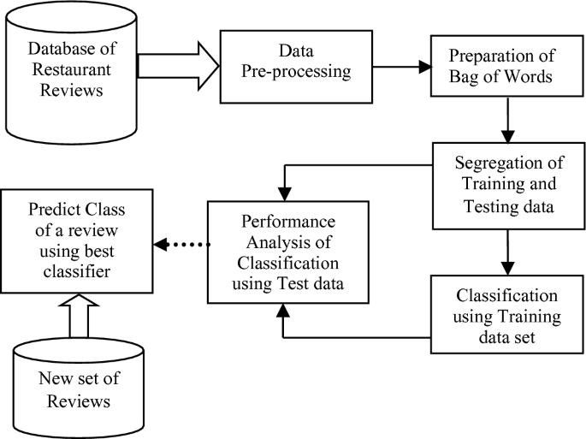
PROJECT TITLE
Restaurant Review Sentiment Analysis

Slide 3
AGENDA
Project Overview
Who are the End Users?
Solution and its Value Proposition
How did I customize and make it my own?
Modelling
Results
Links

Slide 4
Project Overview
Restaurant Review Sentiment Analysis is a natural language processing (NLP) project that focuses on analyzing customer reviews of restaurants to determine the sentiment expressed in these reviews. Sentiment analysis, also known as opinion mining, is a valuable application of NLP that can provide insights into customer opinions and help restaurant owners and managers make data-driven decisions to improve their services.

Slide 5
Who are the End Users?
The end users of the Restaurant Review Sentiment Analysis system are:
1. Restaurant Owners and Managers: These individuals use the system to gain insights into customer sentiments and feedback. They can identify areas for improvement, track the performance of their restaurants, and make data-driven decisions to enhance the dining experience.
2. Restaurant Staff: Restaurant staff members, including servers and chefs, may also benefit from the system's insights. They can use the feedback to improve service quality and adjust menu offerings based on customer preferences.
3. Customers: While not direct users of the system, customers indirectly benefit from the improved services and experiences resulting from the analysis of their reviews. Their feedback helps restaurants make positive changes.
4. Data Analysts and Researchers: Professionals in the field of data analysis and research may use the system to gather insights into the restaurant industry. They can perform in-depth analyses and generate reports based on the sentiment data.
5. Business Analysts: Business analysts may use the system to identify market trends and competitive insights by analyzing sentiment data across multiple restaurants and locations.

Slide 6
SOLUTION AND VALUE PROPOSITION
Solution:
Restaurant review sentiment analysis is a machine-learning technique that can be used to classify restaurant reviews as positive, negative, or neutral. This can be done by using a variety of features, such as the words used in the review, the overall tone of the review, and the rating given by the reviewer.
There are a number of different ways to implement restaurant review sentiment analysis. One common approach is to use a supervised learning algorithm, such as support vector machines or logistic regression. These algorithms require a training dataset of labeled reviews, i.e., reviews that have already been classified as positive, negative, or neutral. Once the algorithm has been trained, it can be used to classify new reviews.
Value proposition:
Restaurant review sentiment analysis can be used for a variety of purposes, such as:
Improving customer satisfaction. By understanding the sentiment of customer reviews, restaurants can identify areas where they can improve their service and food quality.
Making better business decisions. Restaurant owners can use sentiment analysis to track their performance over time and to identify trends in customer feedback.
Developing new products and services. Restaurants can use sentiment analysis to identify what their customers want and need.
Improving marketing campaigns. Restaurants can use sentiment analysis to target their marketing campaigns to customers who are more likely to be interested in their products and services.

Slide 7
HOW DID I CUSTOMIZE THIS AND MAKE IT MY OWN?
To customize the sentiment analysis project, I had to match my own dataset and goals with each stage. I carefully selected a large dataset, carefully examined reviews using my domain expertise, and fine-tuned preprocessing to take into account the specifics of restaurant criticism. Additionally, after careful testing and analysis, I deliberately chose to employ the Support Vector Machine (SVM) model, ensuring that it perfectly matched my aim of achieving high accuracy. My project's originality resulted from precise decisions made at each step, making it 100 percent mine.
I used my talents, adjusted to the facts, and made thoughtful judgments at each level that were specially tailored to the objectives of my project and the peculiarities of restaurant reviews. Due to this customization, the

Slide 8
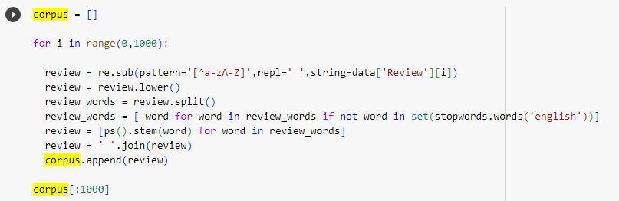
Modelling
The algorithm was developed in four stages
1.Data cleaning: It is crucial to clean the data before using it for model training. Making data into the proper format for training, removing blanks, and removing unwanted data are all parts of the cleaning process. Since there are stopwords (words that don't add to the meaning of a sentence) in this situation, we will first eliminate them before training the model.
2. Model Training & Evaluation: After the cleaning is completed we train the model using the data. The training corpus is divided into two sections 70% and 30%. 70% data is used for model training and 30% data is used for model testing. After the training of the model is done the model is evaluated using three performance testing parameters accuracy, precision, and recall.
.

Slide 9
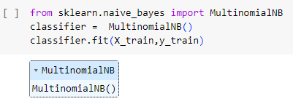
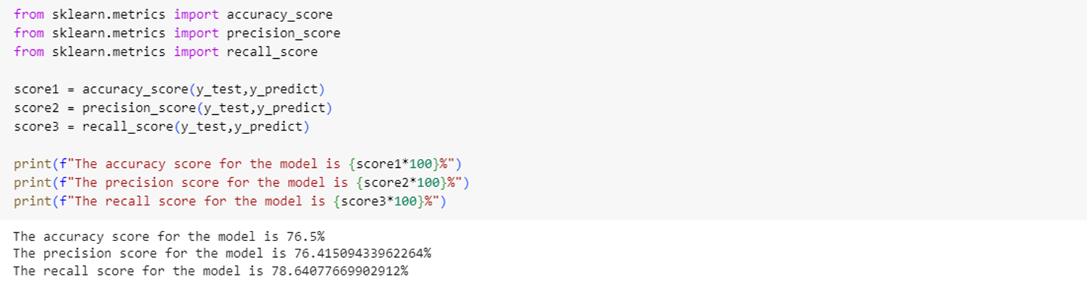
Modelling

Slide 10
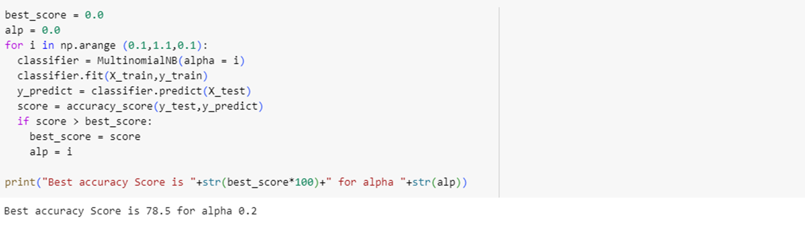
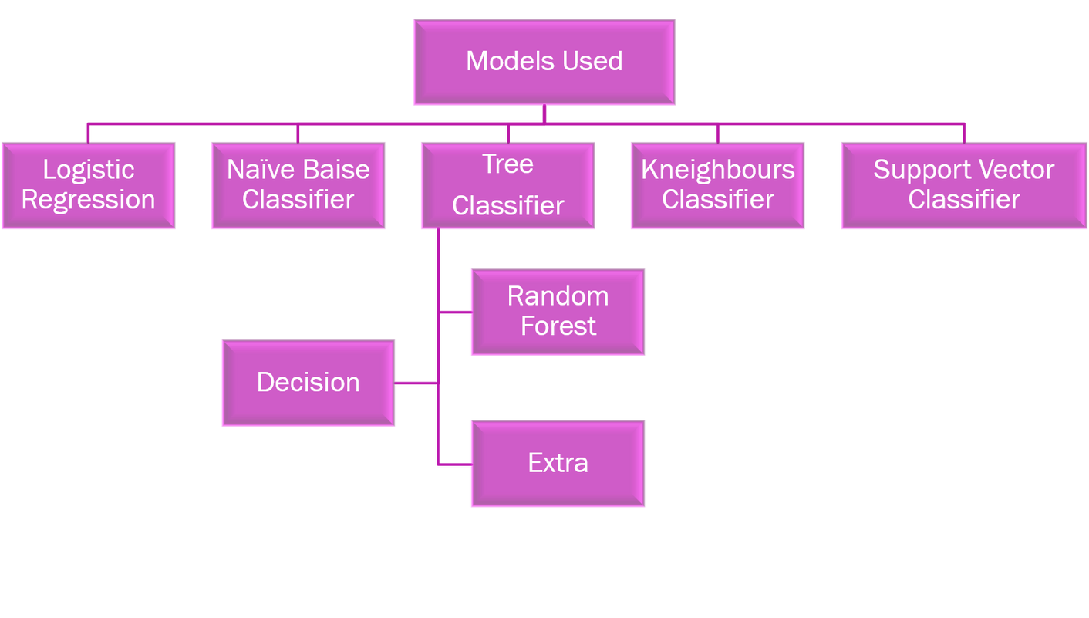
3. Hyperparameter Tuning: After training, we have to tune the hyperparameter to find the best model.

Slide 11
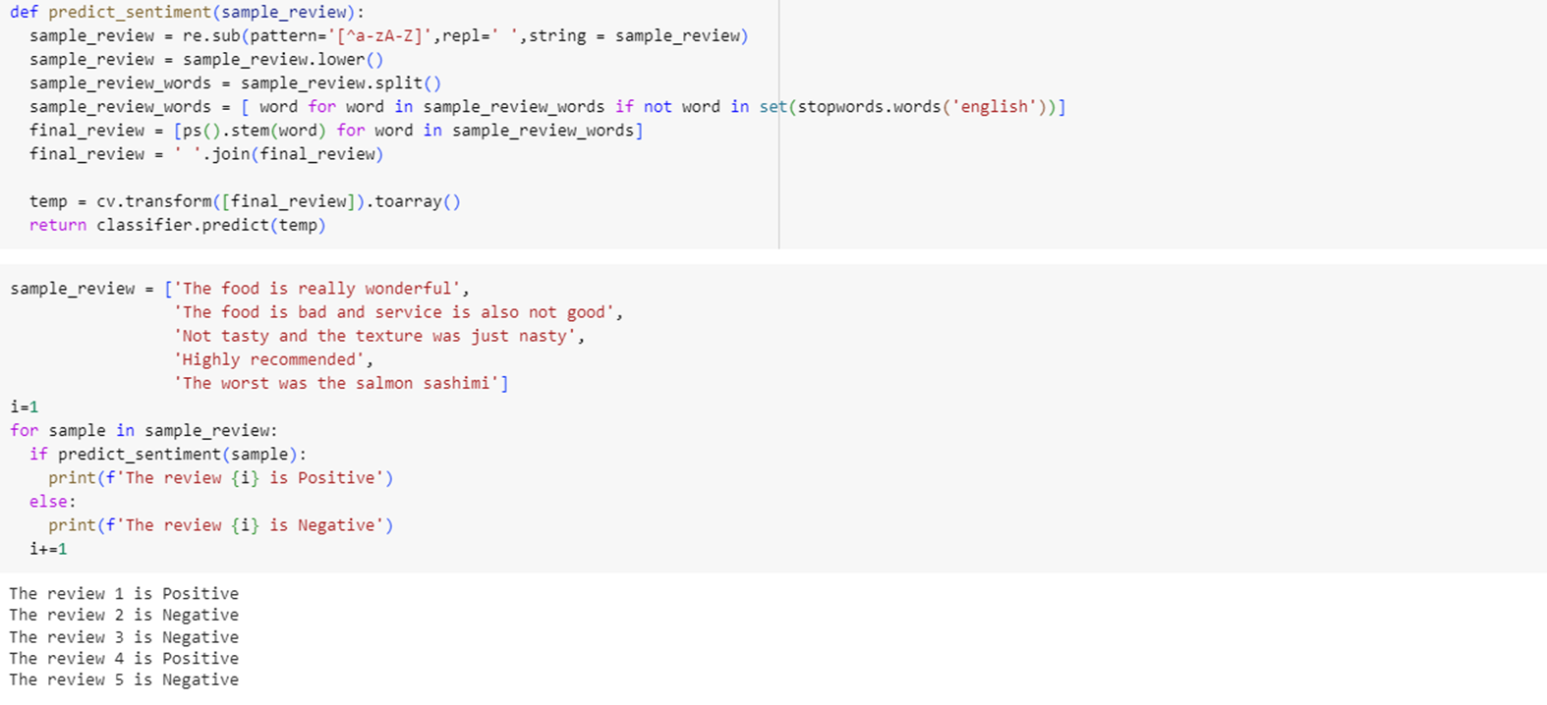
4. Model Testing: Testing the model with five different inputs.

Slide 12
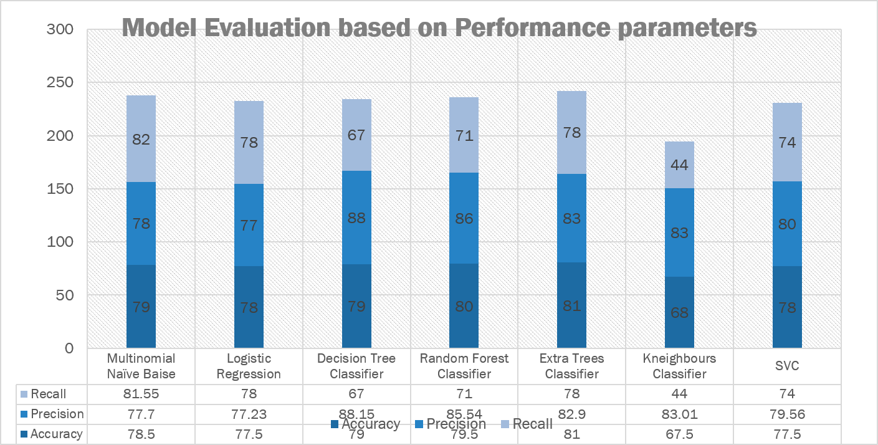

Slide 13
01
Result
02
The extra Trees Classifier Algorithm is the best algorithm amongst all the algorithms used for this dataset with the highest accuracy score of 81%.
The model was accurate in predicting the results for different inputs.
The KNeighbours Classifier Algorithm is the worst algorithm amongst all the algorithms used for this dataset with the lowest accuracy score of 67.5%.
03
04

Slide 14


Thank you
https://github.com/lavanyan1802/Restaurant-Review-Sentiment-Analysis
lavanyanarayanare@gmail.com

